Slide 1
Single Leader Replication

Slide 2
What is replication?
Having redundant copies of database so that application does not fail in the event of a crash, reduce load on each database serving requests

Slide 3
Types of replication
Single leader
Multi leader
Leaderless

Slide 4
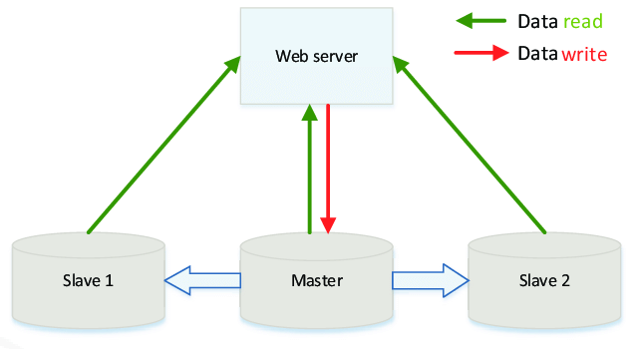
Single Leader Replication Overview
All writes to one master database
Master database sends list of writes to other databases via replication log
Reads can come from any database

Slide 5
Increasing availability
Adding a follower
On follower crash
On leader crash

Slide 6
Adding a follower
Step 1: Initialize the follower using a consistent snapshot of the leader database, which is associated with some position in the replication log
Step 2: The follower can now begin accepting changes from the leader

Slide 7
Dealing with a follower crash
At the time of crash, the follower knows where it was up to in the replication log.
Step 1: On reboot, fetch all of the new changes from leader node
Step 2: Start implementing the changes in the replication log from the index at which the follower node had previously failed.

Slide 8
Dealing with a leader crash (failover)
Step 1: Determine a new leader via some source of consensus (perhaps the most up to date replica)
Step 2: Configure all clients to send writes to new leader
Step 3: Configure all other followers to get changes from new leader

Slide 9
Problems with failover
Some writes from the previous leader may have been propagated by only some or no replicas
Leads to either lost data or inconsistent replicas
Accidental failovers due to network congestion can hurt our database performance even more
If the old leader comes back, need to ensure that it does not think it is the leader and continue to accept writes (split brain)

Slide 10
Types of Single Leader Replication
Synchronous
Client does not receive success message until all replicas complete the write
Strong consistency
Asynchronous
Client receives success message the second that master completes the write
Eventual consistency

Slide 11
Tradeoffs of consistency types
Strong consistency
Data always up to date, but writes take much longer
Eventual consistency
Writes much faster, but clients can make stale reads to a replica

Slide 12
Dealing with eventual consistency
Reading your own writes
Don’t see write after just making it
Monotonic reads
Reads look like they are going back in time
Fix by having each user read from the same replica
Consistent prefix reads
Causal relationship between writes lost because preceding write takes longer to replicate (due to being on different partitions)
Put causally related events on same partition or if not possible keep track of causal dependencies

Slide 13
Reading your own writes
Problem: You may write a change, read from a replica, and then not see the change
Solutions:
Always read from leader for editable areas of application
Always read from the leader or up to date replica for some period after a client write

Slide 14
Monotonic Reads
1:05 - Kate Upton to Jordan: “What’s up”
1:10 - Jordan to Kate Upton: “Not much playing video games”
1:15 - Kate Upton to Jordan: “Wanna come over?”

Slide 15
Monotonic Reads
1:05 - Kate Upton to Jordan: “What’s up”
1:10 - Jordan to Kate Upton: “Not much playing video games”

Slide 16
Monotonic Reads
1:05 - Kate Upton to Jordan: “What’s up”

Slide 17
Consistent Prefix Reads
REPLICA 1
6:22 - (Person A) Oh no the Knicks blew another game
6:25 - (Person B) Screw me!!

Slide 18
Consistent Prefix Reads
REPLICA 2
6:25 - (Person B) Screw me!!

Slide 19
Consistent Prefix Reads
REPLICA 2
6:25 - (Person B) Screw me!!
6:27 - (Person C) On my way!

Slide 20
Replication Log Implementation Options
Copy over SQL statements
Bad because SQL statements are nondeterministic (for example current time)
Use internal write ahead log
Not scalable if changing database engine, says which bytes were changed, other database may have different data in different locations on disk
Use logical log
Describes which rows were modified and how, allows for more future proofing if the underlying database engine changes in the future

Slide 21
Conclusion - Single Leader Replication
Pros:
All writes go through one machine which ensures consistency across replicas
Cons:
Since all writes have to go through one machine write throughput may not be acceptable
Either need to partition the dataset and have a single leader per partition, or look towards other replication strategies

